Slide 1
Software Requirements Specification (SRS) for Bridging Gaps: AI for Diagram Accessibility
Team 22, Reading4All

Slide 2
Brief Overview:
Goal, Users, Focus
Requirements Breakdown:
  Main Functional Requirements
  Design and Look
  Ease of Use and Accessibility
  Performance and Reliability
  Security and Privacy
Upcoming Deadlines

Slide 3
Goal, Users, Focus:
Goal:
  Automatically generate detailed and accessible alt text for technical diagrams.
Users:
  McMaster students, instructors, and accessibility staff.
Focus:
  Inclusion, accessibility, and ease of use. Few constraints on component versions(discussed later).

Slide 4
Main Functional Requirements
Accepts images in JPEG and PNG formats.
Generates descriptive alternative text using AI.
Allows users to edit and save generated alt text.
Keeps a session history of uploaded files and outputs.
Outputs text compatible with screen readers.
Requires McMaster SSO login for access

Slide 5
Design and Look Requirements
Clean, modern interface with McMaster branding.
Supports text resizing up to 200%.
Avoids color-only indicators and ensures all images have alt text.
High color contrast for readability (min 4.5:1).

Slide 6
Ease of Use and Accessibility Requirements
Simple 5-step or fewer upload-to-output process.
Clear feedback after every user action.
Compatible with keyboard navigation and screen readers.
Meets WCAG 2.1 Level AA standards.

Slide 7
Performance and Reliability Requirements
Small images: alt text within 3 seconds.
Large images: alt text within 8 seconds.
Responsive UI (within 300ms).
Handles invalid files gracefully and recovers from failures.

Slide 8
Security and Privacy Requirements
Restricted to McMaster users via SSO login.
Encrypted communication (HTTPS).
Images deleted after each session.
No personal or sensitive data stored or shared.

Slide 9
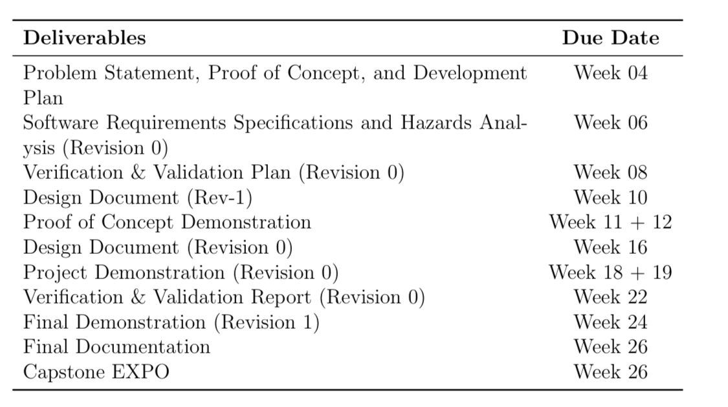

Upcoming Deadlines

Slide 10
Thank you for listening!

